Slide 1

How does it work?
Contextual Rephrasing in Google Assistant
CSE 705
Baasit Sharief (baasitsh@buffalo.edu)
June 8th, 2022

Slide 2
Background

Slide 3

Who wrote Romeo and Juliet?
William Shakespeare
When was he born?
1564

Slide 4
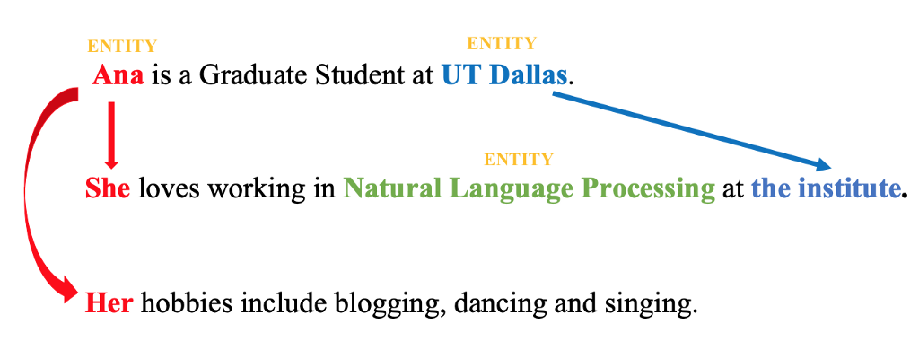
Contextual Rephrasing
Contextual Rephrasing here refers to reference resolution in Natural Language Processing
Reference is a linguistic process where one word in a sentence or discourse refers to another word or entity
What is Coreference resolution?
resolving pronouns to identify which entities are they referring to
“She” and “Her” referring to the entity “Ana” and “the institute” referring to the entity “UT Dallas” are two examples of Reference Resolution
“She” and “Her” to “Ana” is specifically coreference resolution
[1] Unraveling Coreference Resolution in NLP! – Towards AI

Slide 5
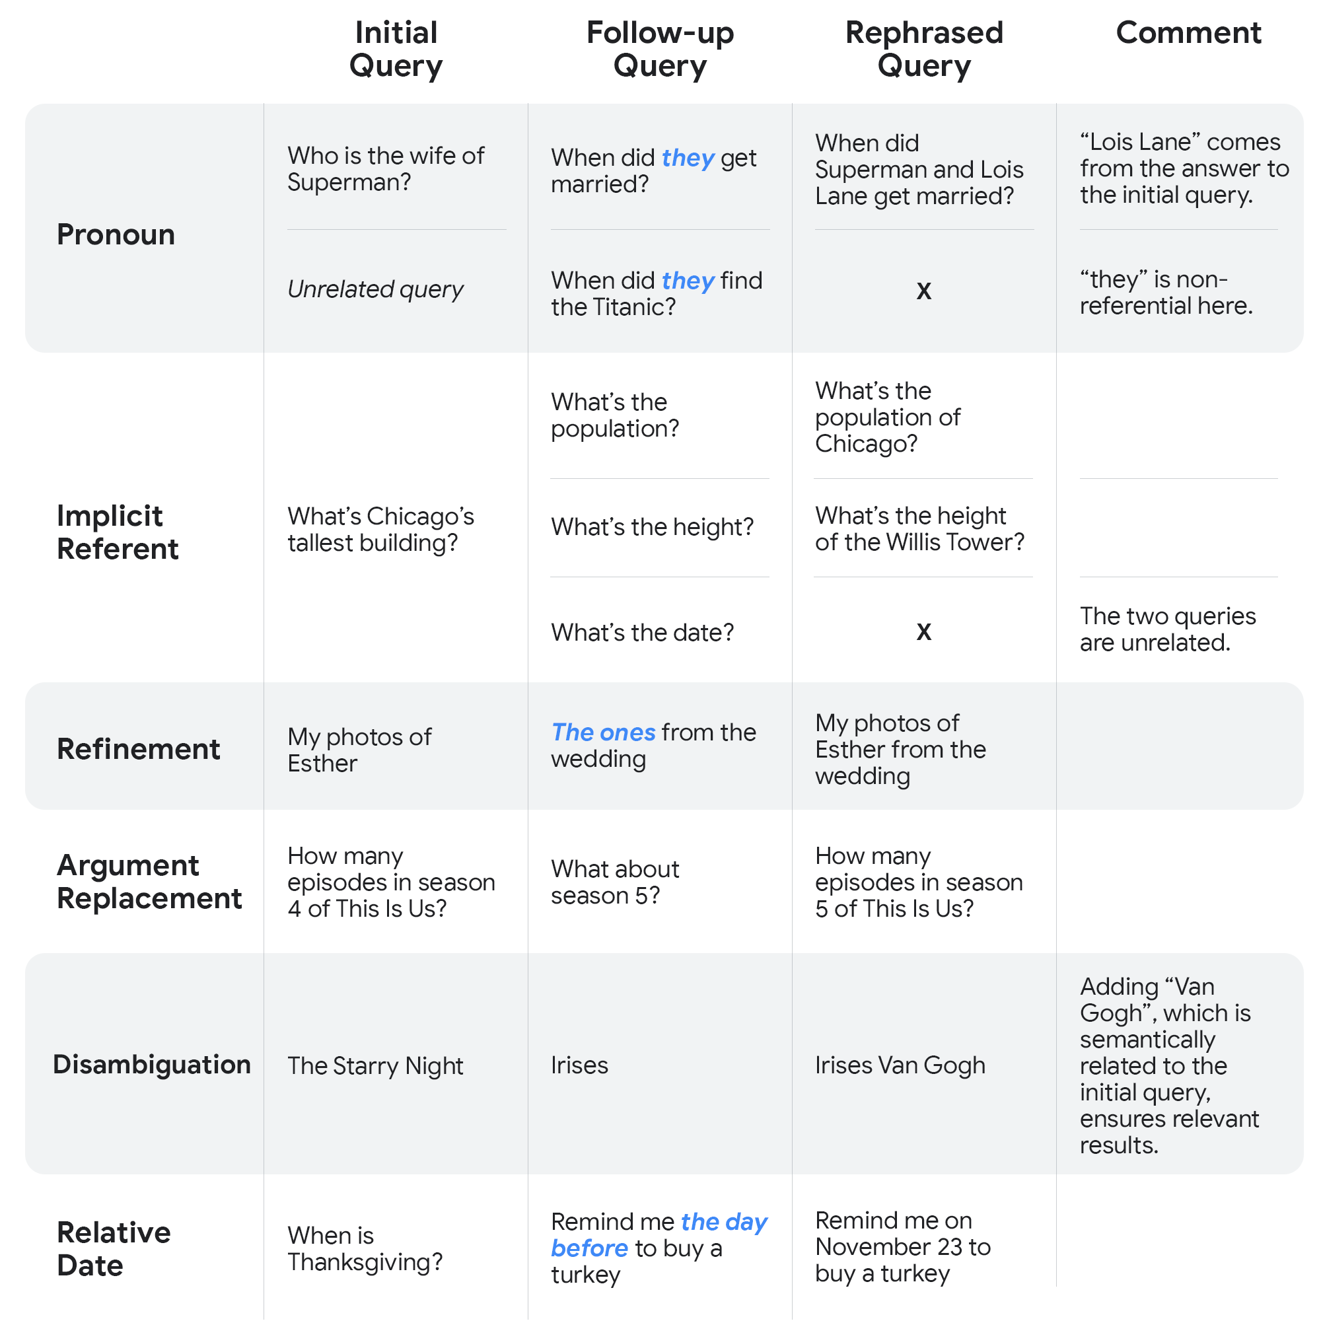
Why does Google Assistant need it?

Slide 6
Why does Google Assistant need it?
Let’s look at some cases of continuous queries where we ask more than 1 query
Given our first example itself,
Us: “Who wrote Romeo and Juliet?”
Asst: “William Shakespeare”
Us: “When was he born?”
It is easy for us to say that “he” refers to William Shakespeare
But how can the Assistant understand that correctly?
Assistants need to robustly handle context and references,
Else users would be required to repeat contextual information in their follow-up queries
[2] Google AI Blog: Contextual Rephrasing in Google Assistant (googleblog.com)

Slide 7
Contextual Rephrasing using ML

Slide 8
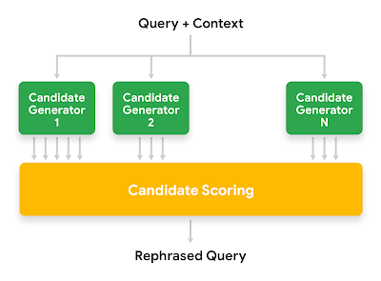
Overview of the architecture
[2] Google AI Blog: Contextual Rephrasing in Google Assistant (googleblog.com)

Slide 9
Candidate Generation
Multiple generators to decide on the best candidate
In other words, ensemble of generators
Different characteristics of each generator
3-types:
Generators based on the analysis of the linguistic structure of the queries
Generators based on query statistics
Generators based on Transformer technologies
[2] Google AI Blog: Contextual Rephrasing in Google Assistant (googleblog.com)
Notes:
1 - use grammatical and morphological rules to perform specific operations — for instance, the replacement of pronouns or other types of referential phrases with antecedents from the context
2 - combine key terms from the current query and its context to create candidates that match popular queries from historical data or common query patterns

Slide 10
Transformer based generators
Transformer architectures like MUM, learn to generate sequences of words according to a number of training samples
LaserTagger and FELIX are used as inspirations
Generate a sequence of text edits to transform the input queries into a rephrasing candidate when presented with a query and its context
[2] Google AI Blog: Contextual Rephrasing in Google Assistant (googleblog.com)
Notes:
2- because of high overlap between the input and output texts, are very fast at inference time, and are not vulnerable to hallucination (i.e., generating text that is not related to the input texts)
3-

Slide 11
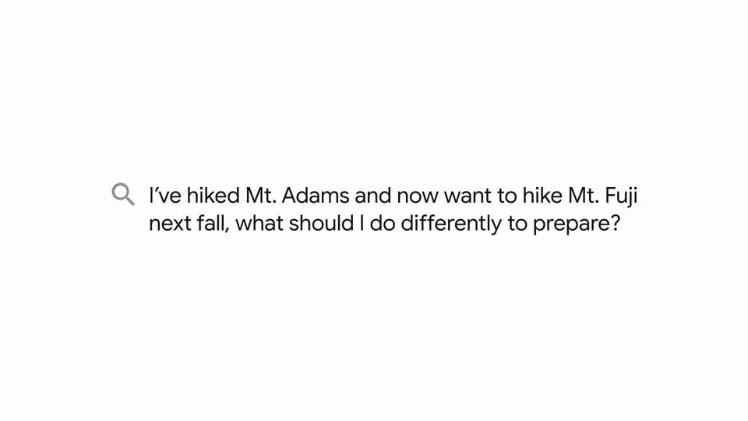
MUM: Multitask Unified Model
[3] MUM: A new AI milestone for understanding information (blog.google)

Slide 12
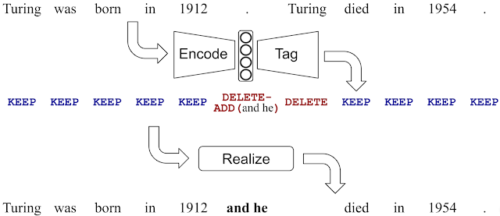
LaserTagger
[4] Google AI Blog: Encode, Tag and Realize: A Controllable and Efficient Approach for Text Generation (googleblog.com)

Slide 13
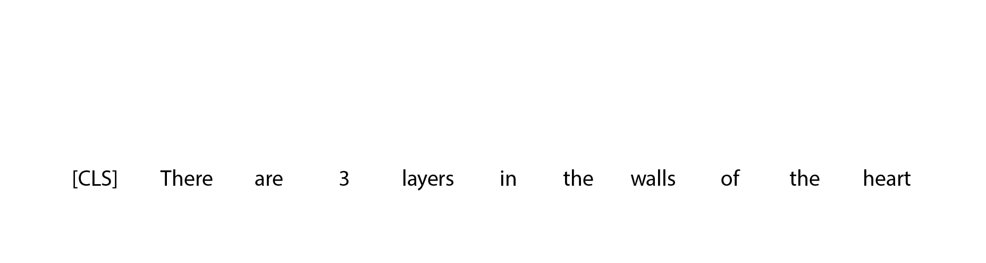
FELIX:Flexible Text Editing Through Tagging and Insertion
[5] Google AI Blog: Introducing FELIX: Flexible Text Editing Through Tagging and Insertion (googleblog.com)

Slide 14
Candidate Scoring
Number of signals extracted from the given candidates to determine the best candidate
Ranging from grammar to contextual information flow
Some signals depend on both candidate and query
Is the topic of the current query similar to the topic of the previous query?
Is the current query a good stand-alone query or does it look incomplete?
Some are completely on the candidate:
How much of the information of the context does the candidate preserve?
Is the candidate well-formed from a linguistic point of view?
[2] Google AI Blog: Contextual Rephrasing in Google Assistant (googleblog.com)

Slide 15
References
Unraveling Coreference Resolution in NLP! – Towards AI
Google AI Blog: Contextual Rephrasing in Google Assistant (googleblog.com)
MUM: A new AI milestone for understanding information (blog.google)
Google AI Blog: Encode, Tag and Realize: A Controllable and Efficient Approach for Text Generation (googleblog.com)
Google AI Blog: Introducing FELIX: Flexible Text Editing Through Tagging and Insertion (googleblog.com)

Slide 16
Thank You

